Slide 2
SIML
(Satellite Image and Machine Learning)

Slide 3
MOSAIKS
(Multi-task Observation using SAtellite Imagery & Kitchen Sinks)

Slide 4
Convolution
Convolutional Neural Networks (CNN)

Slide 6
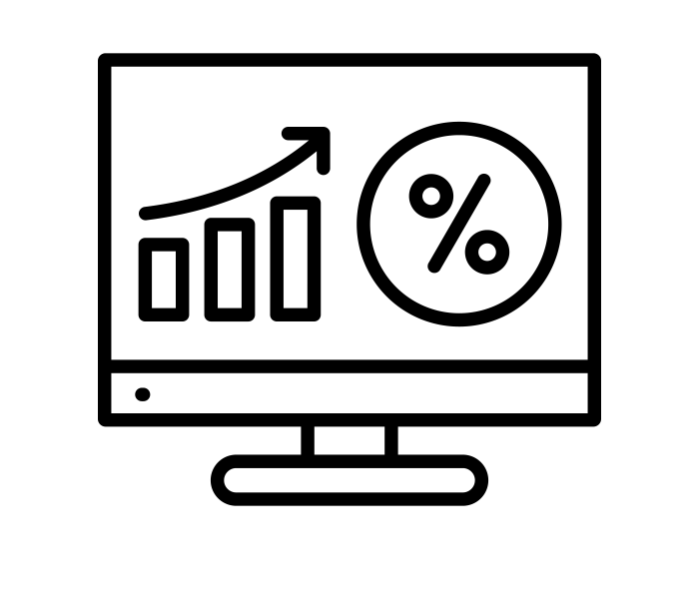
Traditional SIML
Machine Learning
Satellite Images
Corn
Data
Corn
Predictions

Slide 7
Traditional SIML
Machine Learning
Machine Learning
Satellite Images
Satellite Images
Apple
Data
Apple
Predictions

Slide 8
Traditional SIML
Machine Learning
Machine Learning
Satellite Images
Satellite Images
Housing
Data
Housing
Predictions

Slide 9
Linear Process
Machine Learning
Machine Learning
Satellite Images
Satellite Images
Housing
Data
Housing
Predictions

Slide 10
MOSAIKS SIML
Corn
Data
Predictions
Apple
Data
Predictions
Machine Learning
Satellite Images
House
Data
Predictions

Slide 11
MOSAIKS SIML
Corn
Data
Apple
Data
Machine Learning
Satellite Images
Features
House
Data

Slide 12
MOSAIKS SIML
Corn
Data
Apple
Data
Machine Learning
Satellite Images
Tabular Data
House
Data

Slide 13
MOSAIKS SIML
Features represent what is present within a satellite image.
Features are easier to work with than satellite images.
More people know how to work with features than know how to work with satellite images.
The same features can be used by multiple people for multiple prediction tasks.
Features have comparable predictive power to alternative techniques.
Low marginal cost for iteration.
Cost for model creation is much smaller.
Features

Slide 14
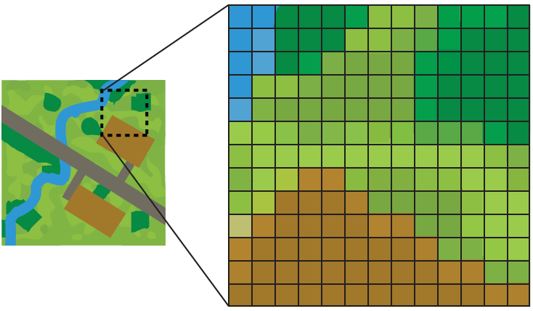
Safe Software: https://docs.safe.com/fme/2020.0/html/FME_Desktop_Documentation/FME_Workbench/!FME_Geometry/Raster.htm

Slide 15
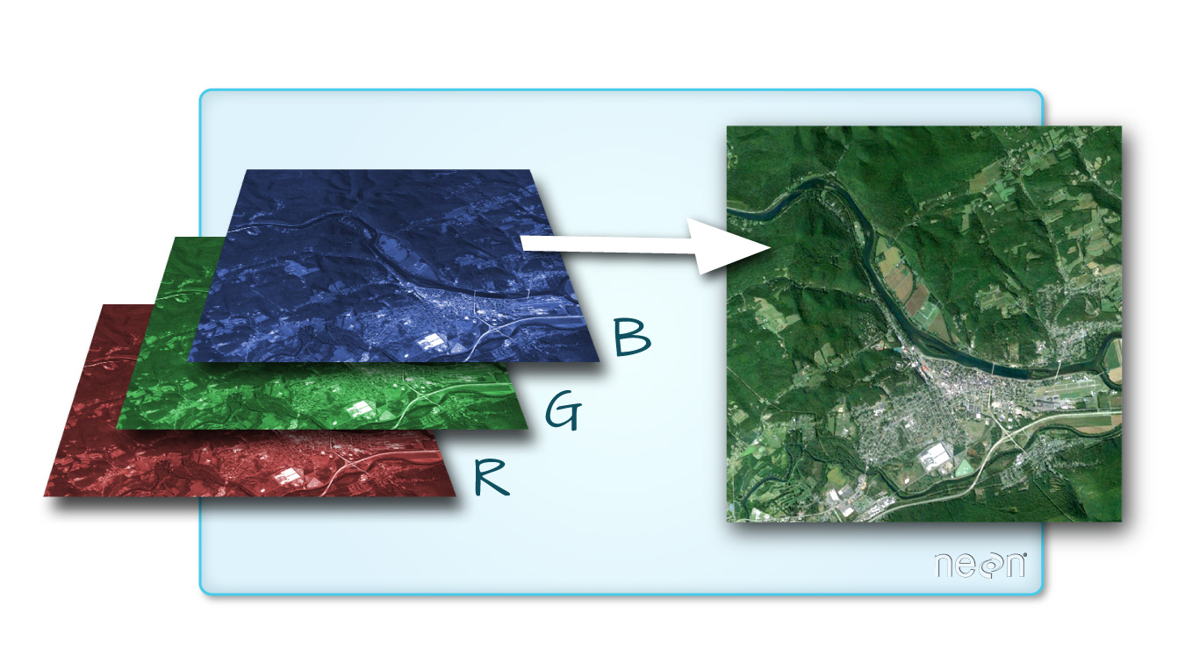

Slide 16
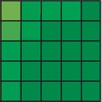
Patches
Field
Tree
Water Tree
Anything
Safe Software: https://docs.safe.com/fme/2020.0/html/FME_Desktop_Documentation/FME_Workbench/!FME_Geometry/Raster.htm

Slide 17
Turning satellite images into features
Satellite Image
Output Matrix
Shadow: Patch
Represents the
presence/absence
of the patch within
the image.
https://towardsdatascience.com/a-comprehensive-introduction-to-different-types-of-convolutions-in-deep-learning-669281e58215

Slide 18
Turning satellite images into features
Field
Tree
Anything
https://towardsdatascience.com/a-comprehensive-introduction-to-different-types-of-convolutions-in-deep-learning-669281e58215

Slide 19
Turning satellite images into features
Field
Tree
Anything
Average
Average
Average
Feature 1
Feature 2
Feature 3
https://towardsdatascience.com/a-comprehensive-introduction-to-different-types-of-convolutions-in-deep-learning-669281e58215

Slide 20
Turning satellite images into features
Feature 1
is correlated with Field.
Feature 2
is correlated with Tree.
Feature 3
is correlated with Anything.

Slide 21
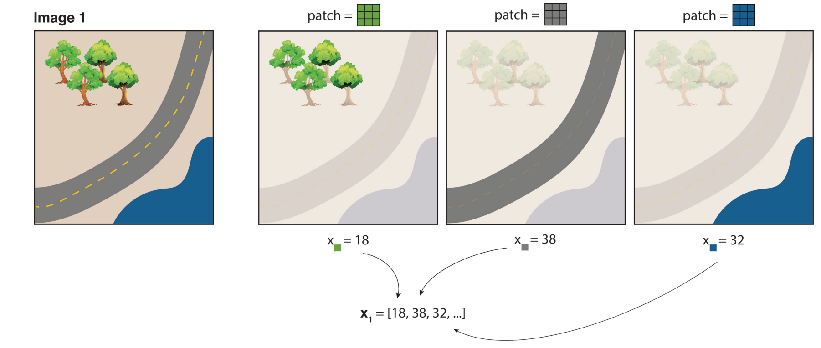
Turning satellite images into features
Images: Rahimi & Recht (2007,2008 a,b),
Tamma Carleton Slide Deck 2023

Slide 22
Ease of Use
Satellite Image
Lat | Lon | Feature 1 | Feature 2 | Feature 3 | ... | Feature 1000 | # of Houses
5.3223 | 6.4422 | 5.2 | 2.2 | 5.2 | 8.6 | 3.2 | 3
5.3224 | 6.4422 | 6.3 | 3.6 | 7.6 | 6.6 | 9.4 | 2
5.3225 | 6.4422 | 1.2 | 2.3 | 3.4 | 5.6 | 6.7 | 0
5.3226 | 6.4422 | 2.3 | 3.4 | 5.3 | 5.3 | 6.6 | 8
5.3227 | 6.4422 | 4.4 | 5.5 | 6.6 | 4.4 | 2.2 | 0
5.3228 | 6.4422 | 3.3 | 4.5 | 5.5 | 6.6 | 6.5 | 3
5.3229 | 6.4422 | 3.3 | 3.4 | 4.4 | 6.6 | 6.6 | 9

Slide 23
Ease of Use
Represents what is in image
Lat | Lon | Feature 1 | Feature 2 | Feature 3 | ... | Feature 1000 | # of Houses
5.3223 | 6.4422 | 5.2 | 2.2 | 5.2 | 8.6 | 3.2 | 3
5.3224 | 6.4422 | 6.3 | 3.6 | 7.6 | 6.6 | 9.4 | 2
5.3225 | 6.4422 | 1.2 | 2.3 | 3.4 | 5.6 | 6.7 | 0
5.3226 | 6.4422 | 2.3 | 3.4 | 5.3 | 5.3 | 6.6 | 8
5.3227 | 6.4422 | 4.4 | 5.5 | 6.6 | 4.4 | 2.2 | 0
5.3228 | 6.4422 | 3.3 | 4.5 | 5.5 | 6.6 | 6.5 | 3
5.3229 | 6.4422 | 3.3 | 3.4 | 4.4 | 6.6 | 6.6 | 9

Slide 24
Ease of Use
Ground Data
Lat | Lon | Feature 1 | Feature 2 | Feature 3 | ... | Feature 1000 | # of Houses
5.3223 | 6.4422 | 5.2 | 2.2 | 5.2 | 8.6 | 3.2 | 3
5.3224 | 6.4422 | 6.3 | 3.6 | 7.6 | 6.6 | 9.4 | 2
5.3225 | 6.4422 | 1.2 | 2.3 | 3.4 | 5.6 | 6.7 | 0
5.3226 | 6.4422 | 2.3 | 3.4 | 5.3 | 5.3 | 6.6 | 8
5.3227 | 6.4422 | 4.4 | 5.5 | 6.6 | 4.4 | 2.2 | 0
5.3228 | 6.4422 | 3.3 | 4.5 | 5.5 | 6.6 | 6.5 | 3
5.3229 | 6.4422 | 3.3 | 3.4 | 4.4 | 6.6 | 6.6 | 9

Slide 25
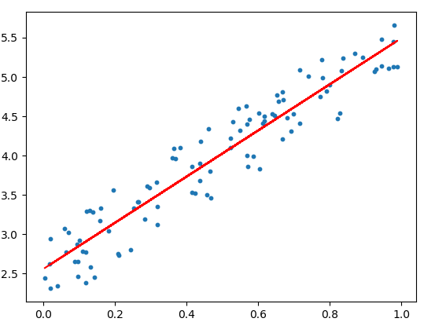
Linear Regression
# of Houses
Feature 143

Slide 26
Turning satellite images into features
Dimension Reduction
Gigabytes
(3D Raster)
Kilobytes
(1D Array)
Images left to righ (Noun Project)t: Vectors Market, LSE Designs

Slide 27
Turning satellite images into features
Satellite Images
Easy
To Use
Images left to righ (Noun Project)t: Vectors Market, LSE Designs

Slide 28
Turning satellite images into features
Satellite Images
Have Predictive
Power
Images left to righ (Noun Project)t: Vectors Market, LSE Designs

Slide 29
Turning satellite images into features
Which Patches?
Images left to righ (Noun Project)t: Vectors Market, LSE Designs

Slide 30
Turning satellite images into features
Completely Random
Images left to righ (Noun Project)t: Vectors Market, LSE Designs

Slide 31
What do our features look like?
Images left to righ (Noun Project)t: Vectors Market, LSE Designs

Slide 32
One Thousand Features
Images left to righ (Noun Project)t: Vectors Market, LSE Designs

Slide 33
Works Great!
Images left to righ (Noun Project)t: Vectors Market, LSE Designs

Slide 34
¿Qué hace? What does it do?
N/A | N/A | N/A | N/A | N/A | N/A | N/A | N/A | N/A | N/A
N/A | N/A | N/A | N/A | N/A | N/A | N/A | N/A | N/A | N/A
N/A | N/A | N/A | N/A | N/A | N/A | N/A | N/A | N/A | N/A
N/A | N/A | N/A | N/A | N/A | N/A | N/A | N/A | N/A | N/A
N/A | N/A |  | N/A | N/A | N/A | N/A | N/A | N/A | N/A
 |  |  |  |  | N/A | N/A | N/A | N/A | N/A
 |  |  |  |  | N/A | N/A | N/A | N/A | N/A
N/A |  |  |  |  |  | N/A | N/A | N/A | N/A
 |  |  | N/A |  | N/A | N/A |  | N/A | N/A
 |  |  |  |  | N/A |  |  | N/A | N/A
Expande Espacialmente los Datos
Spatially Expand Data

Slide 35
¿Qué hace? What does it do?
N/A | N/A | N/A | N/A | N/A | N/A | N/A | N/A | N/A | N/A
N/A | N/A | N/A | N/A | N/A | N/A | N/A | N/A | N/A | N/A
N/A | N/A | N/A | N/A | N/A | N/A | N/A | N/A | N/A | N/A
N/A | N/A | N/A | N/A | N/A | N/A | N/A | N/A | N/A | N/A
N/A | N/A | N/A | N/A | N/A | N/A | N/A | N/A | N/A | N/A
N/A | N/A | N/A | N/A | N/A | N/A | N/A | N/A | N/A | N/A
N/A | N/A | N/A | N/A | N/A | N/A | N/A | N/A | N/A | N/A
N/A | N/A | N/A | N/A | N/A | N/A | N/A | N/A | N/A | N/A
N/A | N/A | N/A | N/A | N/A | N/A | N/A | N/A | N/A | N/A
N/A | N/A | N/A | N/A | N/A | N/A | N/A | N/A | N/A | N/A
Tiempo
N/A | N/A | N/A | N/A | N/A | N/A | N/A | N/A | N/A | N/A
N/A | N/A | N/A | N/A | N/A | N/A | N/A | N/A | N/A | N/A
N/A | N/A | N/A | N/A | N/A | N/A | N/A | N/A | N/A | N/A
N/A | N/A | N/A | N/A | N/A | N/A | N/A | N/A | N/A | N/A
N/A | N/A | N/A | N/A | N/A | N/A | N/A | N/A | N/A | N/A
N/A | N/A | N/A | N/A | N/A | N/A | N/A | N/A | N/A | N/A
N/A | N/A | N/A | N/A | N/A | N/A | N/A | N/A | N/A | N/A
N/A | N/A | N/A | N/A | N/A | N/A | N/A | N/A | N/A | N/A
N/A | N/A | N/A | N/A | N/A | N/A | N/A | N/A | N/A | N/A
N/A | N/A | N/A | N/A | N/A | N/A | N/A | N/A | N/A | N/A
N/A | N/A | N/A | N/A | N/A | N/A | N/A | N/A | N/A | N/A
N/A | N/A | N/A | N/A | N/A | N/A | N/A | N/A | N/A | N/A
N/A | N/A | N/A | N/A | N/A | N/A | N/A | N/A | N/A | N/A
N/A | N/A | N/A | N/A | N/A | N/A | N/A | N/A | N/A | N/A
N/A | N/A | N/A | N/A | N/A | N/A | N/A | N/A | N/A | N/A
N/A | N/A | N/A | N/A | N/A | N/A | N/A | N/A | N/A | N/A
N/A | N/A | N/A | N/A | N/A | N/A | N/A | N/A | N/A | N/A
N/A | N/A | N/A | N/A | N/A | N/A | N/A | N/A | N/A | N/A
N/A | N/A | N/A | N/A | N/A | N/A | N/A | N/A | N/A | N/A
N/A | N/A | N/A | N/A | N/A | N/A | N/A | N/A | N/A | N/A
Expandir Datos Temporalmente
Temporally Expand Data

Slide 36
¿Qué hace? What does it do?
Tiempo
N/A | N/A | N/A | N/A | N/A | N/A | N/A | N/A | N/A | N/A
N/A | N/A | N/A | N/A | N/A | N/A | N/A | N/A | N/A | N/A
N/A | N/A | N/A | N/A | N/A | N/A | N/A | N/A | N/A | N/A
N/A | N/A | N/A | N/A | N/A | N/A | N/A | N/A | N/A | N/A
N/A | N/A | N/A | N/A | N/A | N/A | N/A | N/A | N/A | N/A
N/A | N/A | N/A | N/A | N/A | N/A | N/A | N/A | N/A | N/A
N/A | N/A | N/A | N/A | N/A | N/A | N/A | N/A | N/A | N/A
N/A | N/A | N/A | N/A | N/A | N/A | N/A | N/A | N/A | N/A
N/A | N/A | N/A | N/A | N/A | N/A | N/A | N/A | N/A | N/A
N/A | N/A | N/A | N/A | N/A | N/A | N/A | N/A | N/A | N/A
N/A | N/A | N/A | N/A | N/A | N/A | N/A | N/A | N/A | N/A
N/A | N/A | N/A | N/A | N/A | N/A | N/A | N/A | N/A | N/A
N/A | N/A | N/A | N/A | N/A | N/A | N/A | N/A | N/A | N/A
N/A | N/A | N/A | N/A | N/A | N/A | N/A | N/A | N/A | N/A
N/A | N/A | N/A | N/A | N/A | N/A | N/A | N/A | N/A | N/A
N/A | N/A | N/A | N/A | N/A | N/A | N/A | N/A | N/A | N/A
N/A | N/A | N/A | N/A | N/A | N/A | N/A | N/A | N/A | N/A
N/A | N/A | N/A | N/A | N/A | N/A | N/A | N/A | N/A | N/A
N/A | N/A | N/A | N/A | N/A | N/A | N/A | N/A | N/A | N/A
N/A | N/A | N/A | N/A | N/A | N/A | N/A | N/A | N/A | N/A
N/A | N/A | N/A | N/A | N/A | N/A | N/A | N/A | N/A | N/A
N/A | N/A | N/A | N/A | N/A | N/A | N/A | N/A | N/A | N/A
N/A | N/A | N/A | N/A | N/A | N/A | N/A | N/A | N/A | N/A
N/A | N/A | N/A | N/A | N/A | N/A | N/A | N/A | N/A | N/A
N/A | N/A | N/A | N/A | N/A | N/A | N/A | N/A | N/A | N/A
N/A | N/A | N/A | N/A | N/A | N/A | N/A | N/A | N/A | N/A
N/A | N/A | N/A | N/A | N/A | N/A | N/A | N/A | N/A | N/A
N/A | N/A | N/A | N/A | N/A | N/A | N/A | N/A | N/A | N/A
N/A | N/A | N/A | N/A | N/A | N/A | N/A | N/A | N/A | N/A
N/A | N/A | N/A | N/A | N/A | N/A | N/A | N/A | N/A | N/A
Expandir Datos Temporalmente
Temporally Expand Data

Slide 37
¿Qué hace? What does it do?
Aumentar Resolución
Increase Resolution

Slide 38
MOSAIKS Limitations
Raster
Low Resolution
Alternative Techniques
Small Community
Limited Use Cases (Current SIML Industry)
Barriers to SIML use
Features

Slide 39
MOSAIKS IRL
Zambia
MOSAIKS.org
Global SDG
Features

Slide 40
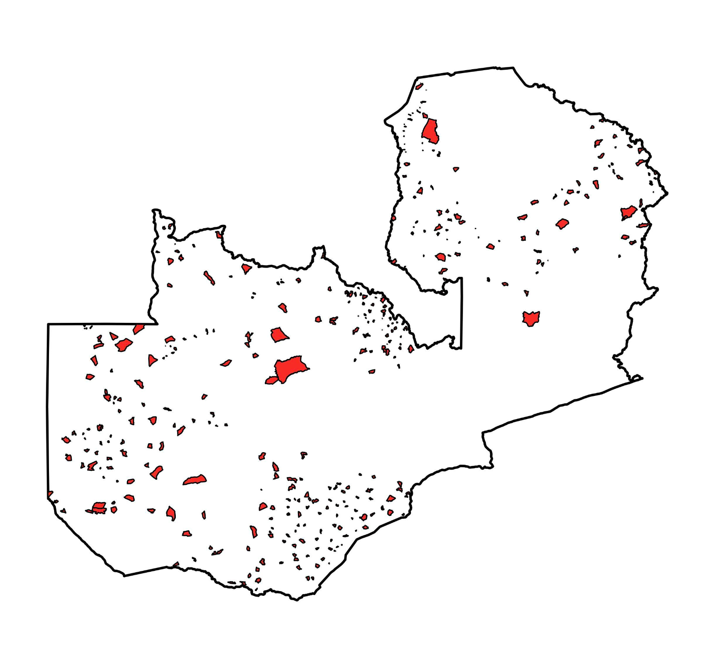
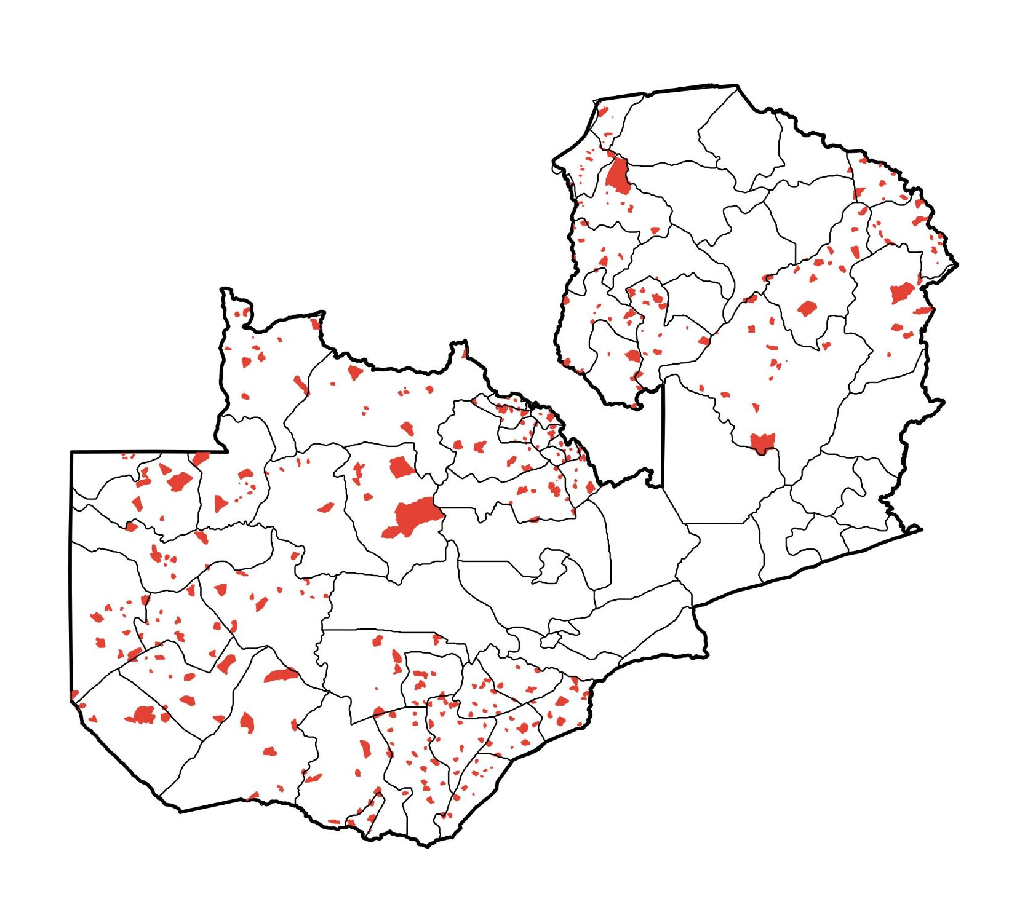
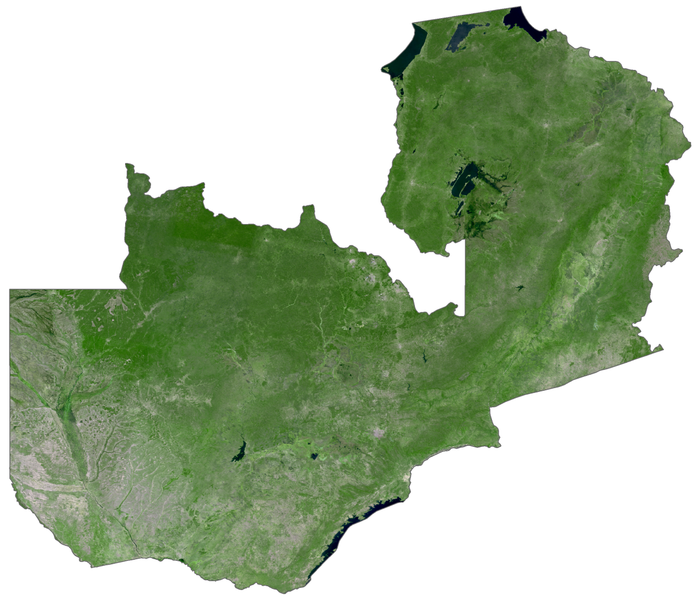
Zambia Crop Forecast Survey (CFS)
Agricultural data collected here in red
Data Context:
Zambian Ministry of Agriculture collects data from individual farms on a wide range of agricultural outcomes
Public Satellite Image Data
Temporal coverage: 2007-2022
Spatial coverage: 680 unique survey enumeration areas
No comprehensive agricultural information available outside of survey areas
Notes:
For these reasons, MOSAIKS is emerging as an ideal technology for regions lacking the scale of data and resources to employ traditional SIML methods. To illustrate this, we look at Zambia as a use case example. Not only is this region highly vulnerable to climate change, but an alarming 10% of the current population experiences severe food insecurity.
Since 2007, the Zambian Ministry of Agriculture has conducted an annual crop forecast survey, collecting essential data on various agricultural metrics from individual farms. This includes variables like crop yields, area planted, tillage practices, reasons for non-harvest, fertilization techniques, and crop disease. The survey extends across 680 unique survey areas, marked in red on the map.
The white space on the map highlights areas outside of the survey’s coverage, which results in significant gaps in agricultural data. These data gaps greatly restrict the utility of the survey information for research, planning, and decision making purposes, and also underscore the need for SIML in this region.
To address these challenges, we apply the MOSAIKS technique, leveraging publicly available satellite imagery from Seninel 2.

Slide 41
Objectives
Objective 1
Demonstrate efficacy and task agnostic nature of MOSAIKS process in a low-income context
Objective 2
Fill Agricultural Data Gap in Zambia
Objective 3
Contribute to broader MOSAIKS ecosystem
Notes:
Our first objective was to demonstrate the efficacy and task agnostic nature of the MOSAIKS process, covering a range of time and predictions tasks, within a unique setting characterized by limited resources and data
After validating our model performances in areas with available survey data, our second objective was to extend its application to areas outside of the survey range in Zambia, filling existing data gaps. This objective aims to enhance understanding of agricultural practices in the region, supporting efforts to address food security in changing climates.
Our third objective was to use this work as a case study to contribute to the broader MOSAIKS ecosystem by presenting a public application of the technique in a novel context: predicting multiple variables, over time, in a low-income country with typically poor data quality. I will now hand it over to Andrew to summarize how our team met these objectives.

Slide 42
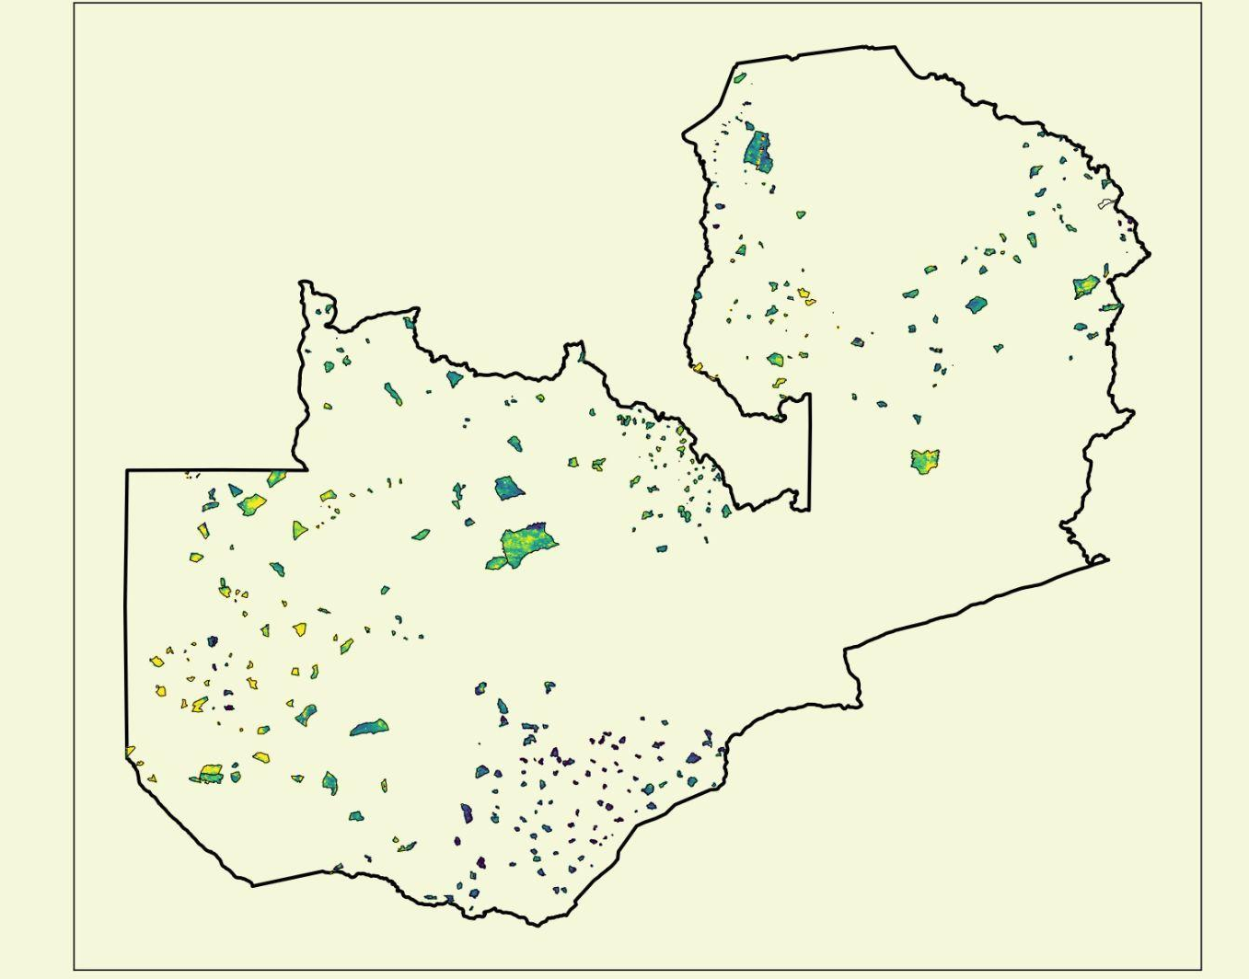
Objective 1: Demonstrate MOSAIKS
Notes:
To meet our first objective and demonstrate the efficacy of the MOSAIKS process at a high spatial resolution, we first trained a model on the survey data that uses our features to predict the fraction of planted area that was actually harvested in each survey area.
We’re going to zoom into this map of zambia and focus on this larger survey area that you see in the middle of the country

Slide 43
Objective 1: Demonstrate MOSAIKS
Notes:
To meet our first objective and demonstrate the efficacy of the MOSAIKS process at a high spatial resolution, we first trained a model on the survey data that uses our features to predict the fraction of planted area that was actually harvested in each survey area.
We’re going to zoom into this map of zambia and focus on this larger survey area that you see in the middle of the country

Slide 44
Objective 1: Demonstrate MOSAIKS

Slide 45
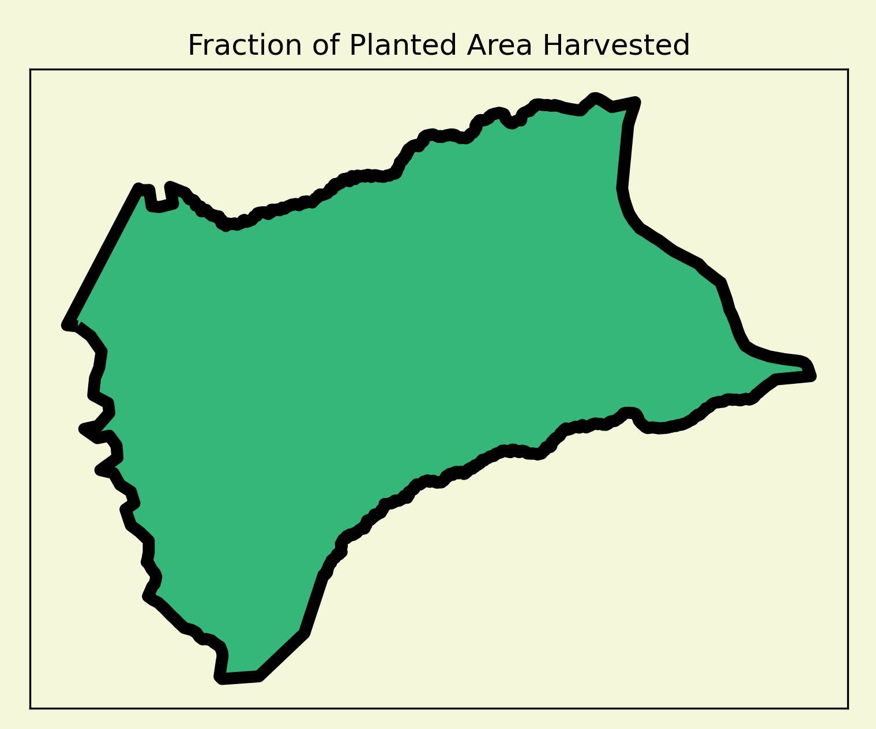
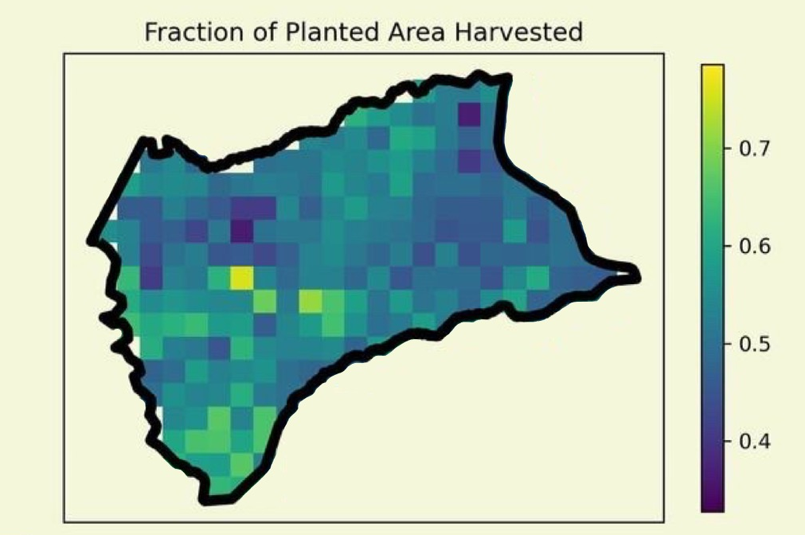
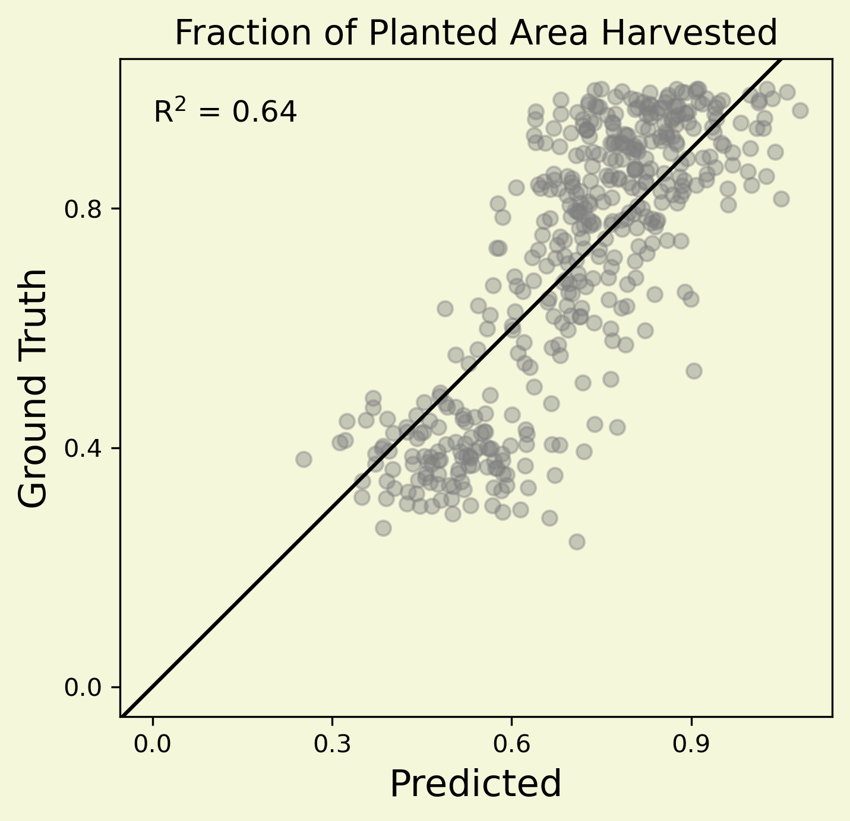
Objective 1: Demonstrate MOSAIKS
Observed Survey Data
Predictions
Notes:
Although our survey data in this plot on the left is aggregated to the survey area level (which is why the plot on the left is one color), we featurized satellite imagery at a much higher spatial resolution, allowing us to generate predictions at this higher resolution which is why this plot on the right has multiple colors. You can see that, if we were to average the colors in the plot on the right, we’d approximately end up with the color in the plot on the left. We made predictions for every survey area in the country, each of which is represented by a point on this scatterplot on the right
Our results show that our features alone are capable of explaining over 60% of the variation in fraction of planted area harvested within each survey area in our validation set.

Slide 46
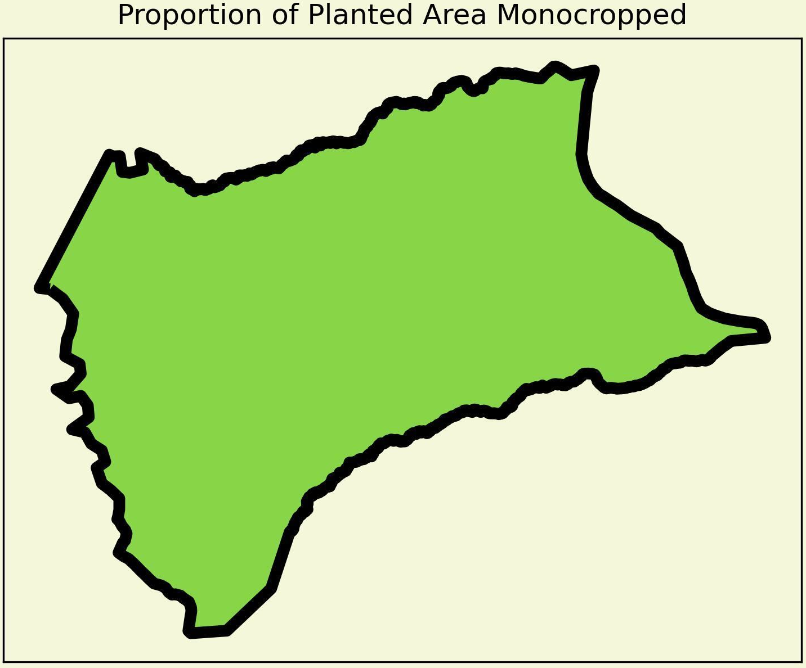
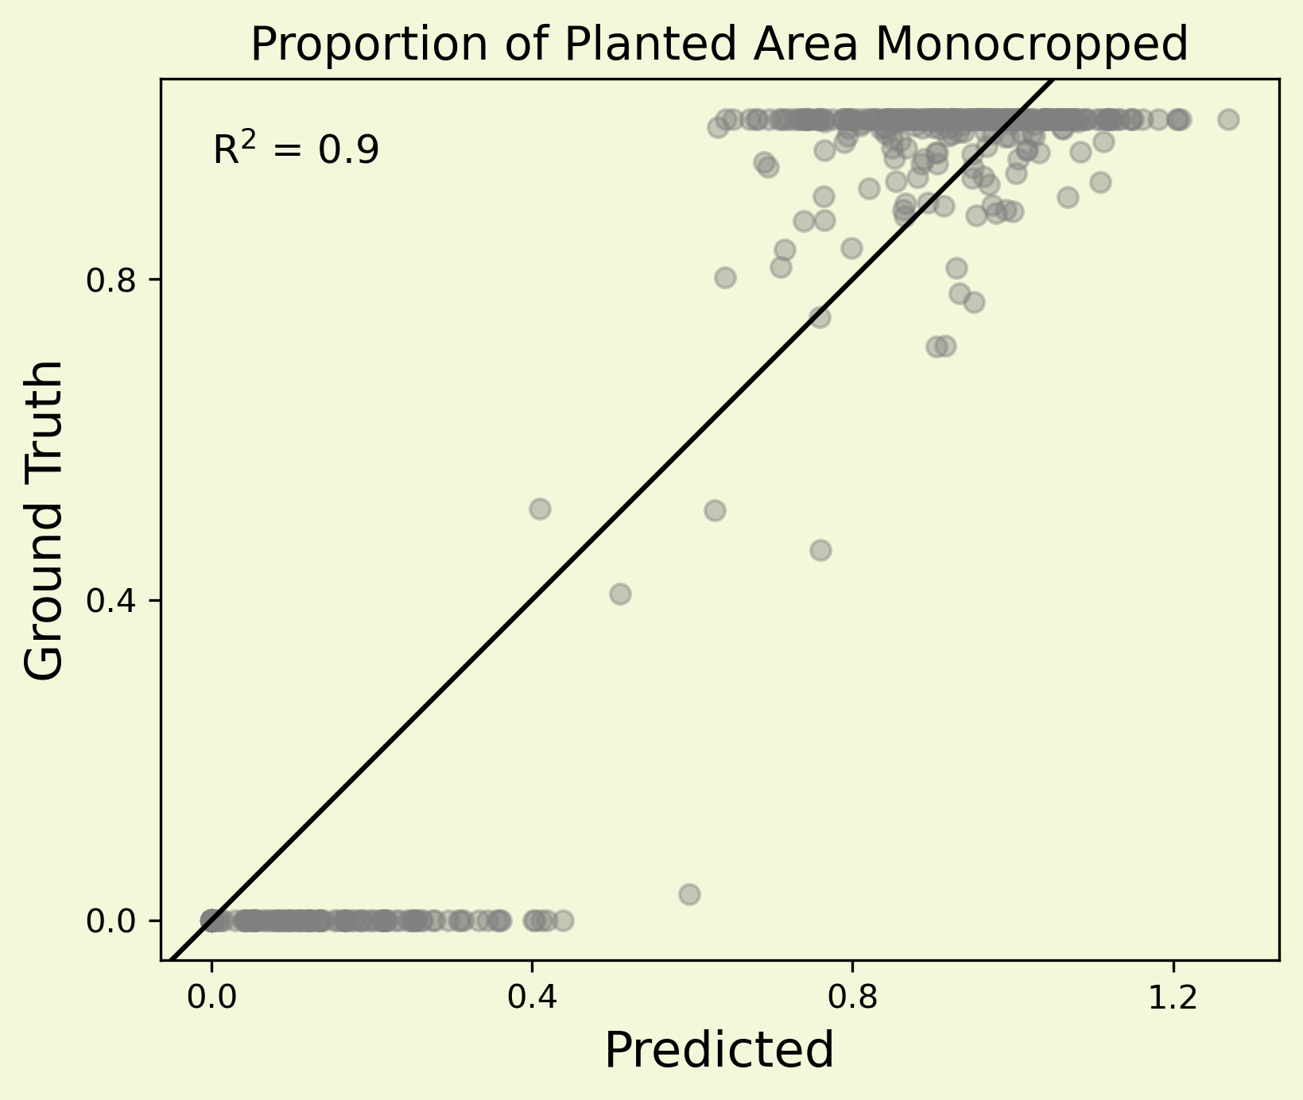
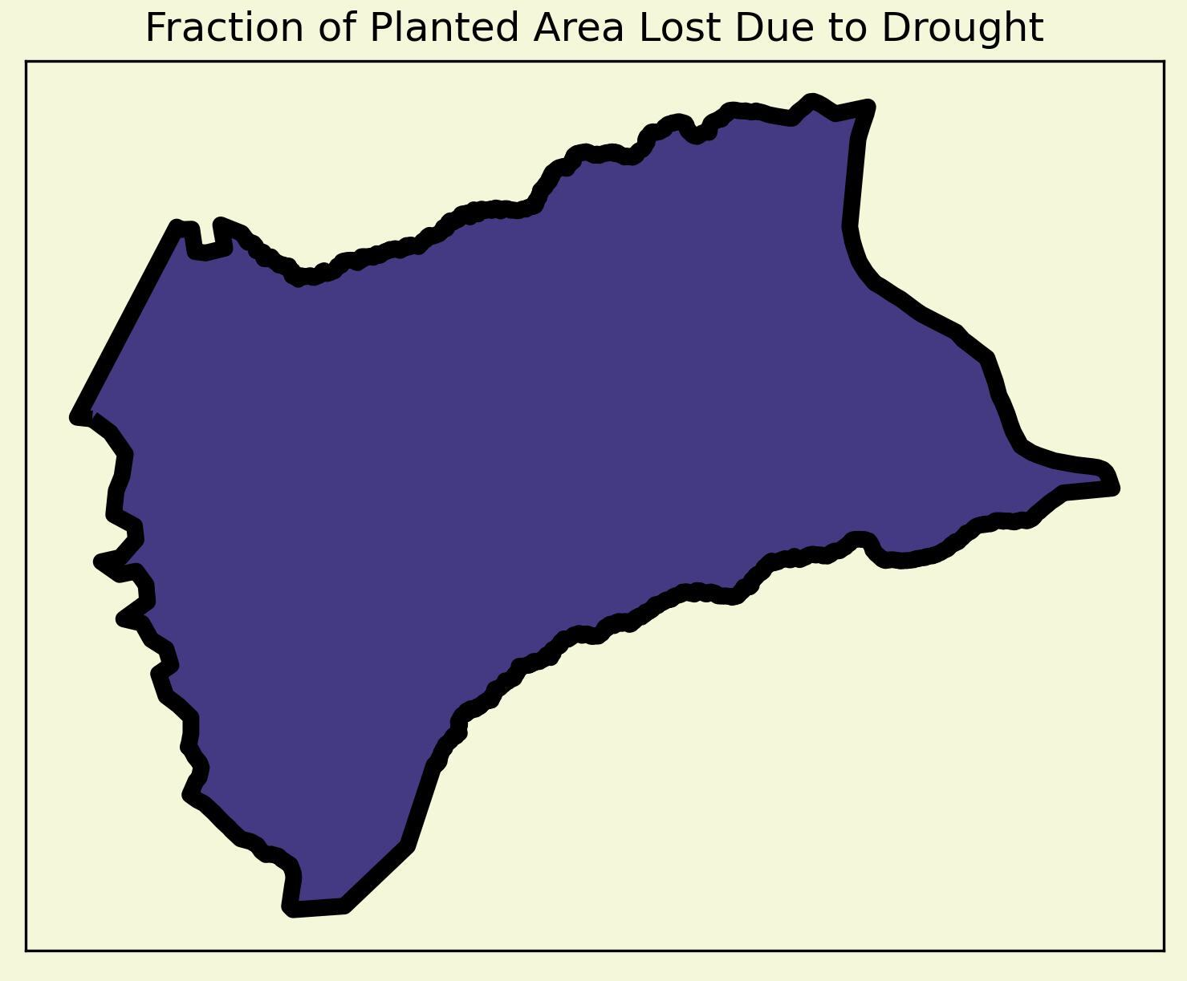
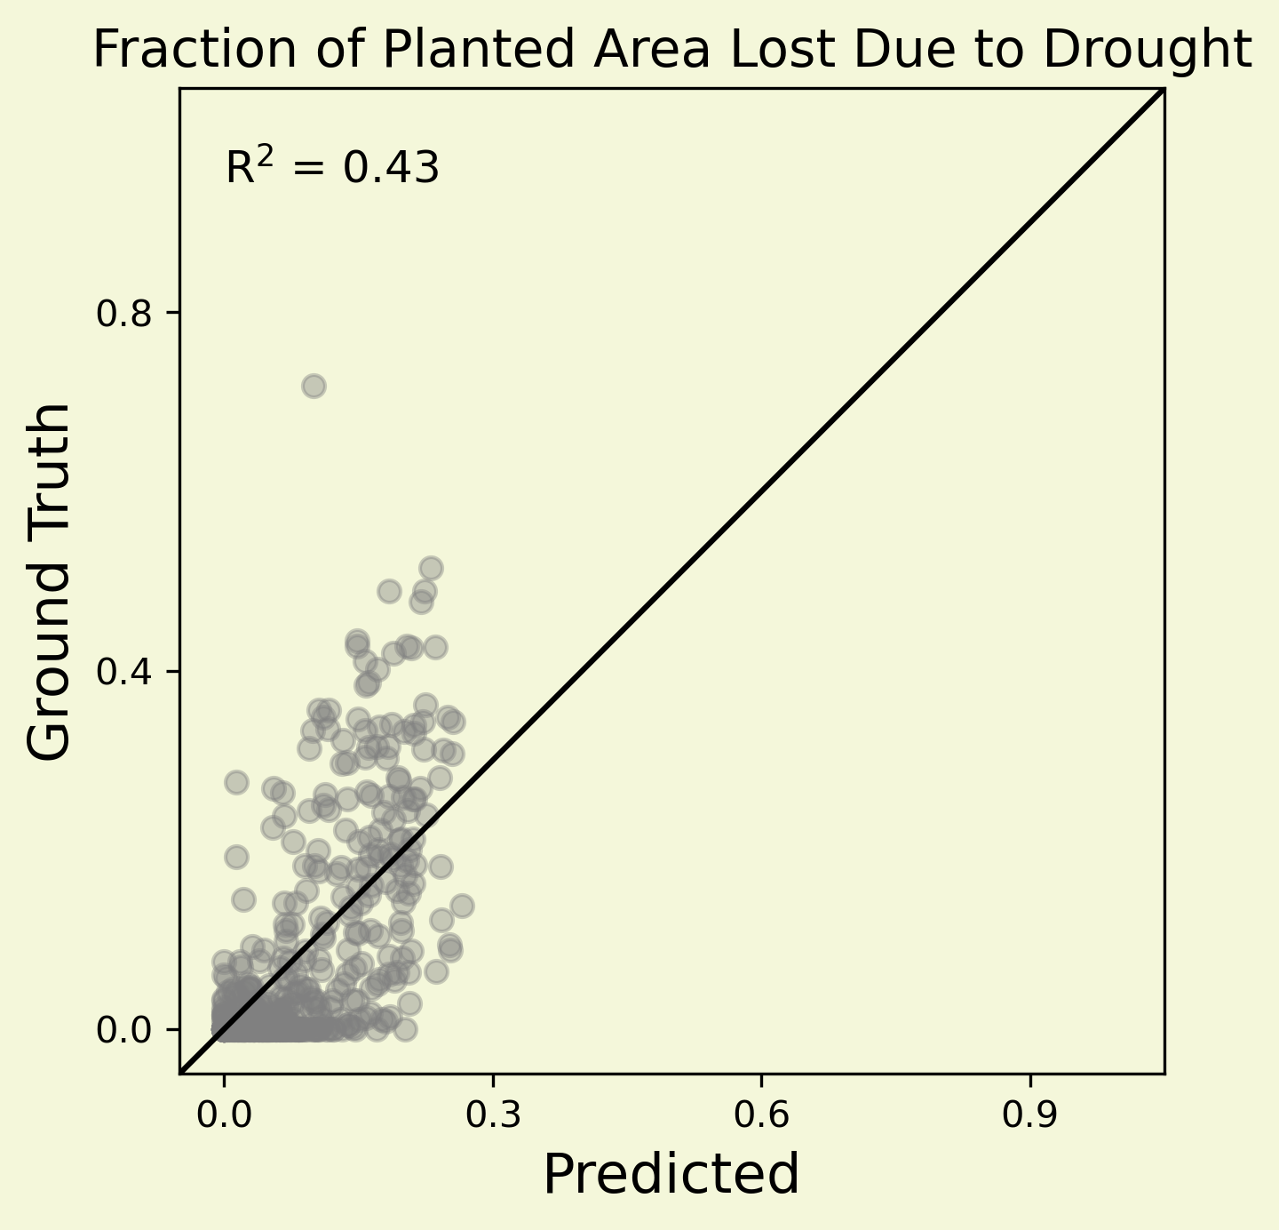
Objective 1: Demonstrate MOSAIKS
Observed Survey Data
Predictions
Performance
Notes:
However, we did not restrict ourselves just to this one variable.
To properly demonstrate the task-agnostic nature of the MOSAIKS process, we trained different models and used the same set of features to predict 27 other variables present in the survey. We were able to achieve high performance on many of our variables. Here, we show our predictions for the fraction of planted area that was monocropped, and the fraction of planted area that was lost due to drought.

Slide 47
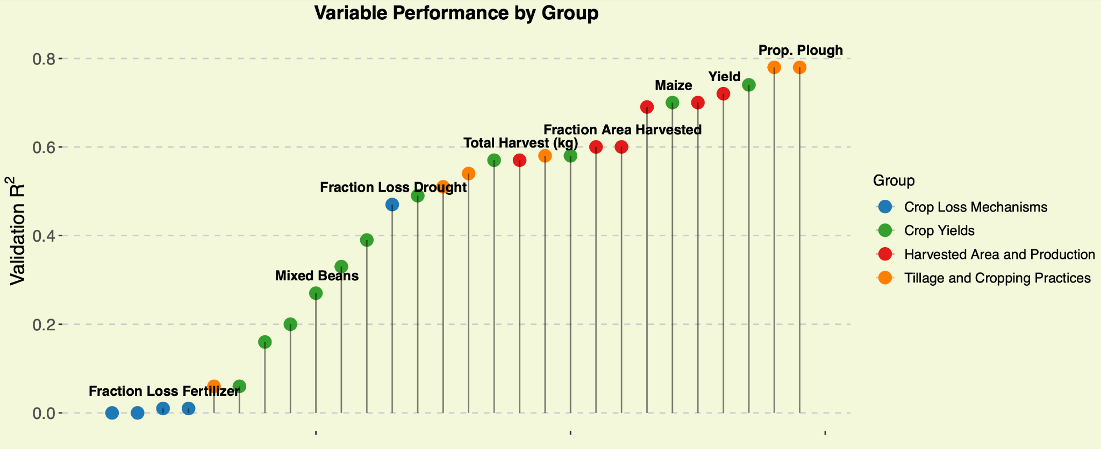
Objective 1: Demonstrate MOSAIKS
Notes:
Here is a more comprehensive plot for the performance of all of our variables, the best of which are on the far right. We classified our variables into 4 groups: Crop loss mechanisms, Crop yields, Overall Harvested area and Production, and tillage and cropping practices. Each of these groups contain important variables that we felt were pertinent for understanding farmer adaptation to climate change. We would like to reiterate that typically, a deep learning pipeline would have to be customized to predict a single one of these variables. Here, we’re using the same features and pipeline to predict 28 different outcomes that far more richly describe agriculture in this region than any single metric could do.
Overall our worst performing variables on the far left side of the plot tended to be those that had known data quality issues. It is important to reiterate: our model can only be as good as the data that we’re training it on, and although MOSAIKS can be used to fill data gaps, it does not replace the need for the collection of data on the ground.

Slide 48
Objective 2: Fill Data Gap (spatial)
Survey Enumeration
Areas
Prediction
Map
Notes:
This brings us to our second objective. We have predictions inside the red survey areas that we’ve validated are accurate, but we haven’t filled any data gaps since the survey already tells us these data. So besides showing that our models work, whats the point if we can only use them to predict values that we already know?
Well, we generated features across the entire country. So after validating that the features have predictive power in a model, we were confident in applying our models to the rest of the country where we don’t have survey data, but we do have features. To meet our second objective and fill the data gap, we projected our predictions for each variable across the entire country, a few of which are shown here.

Slide 49
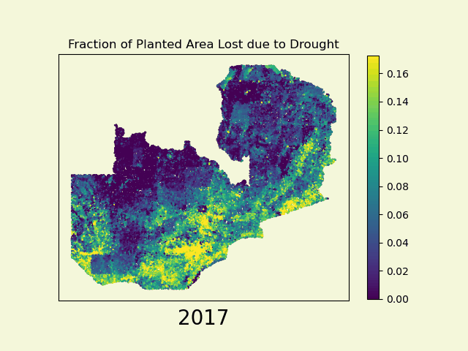
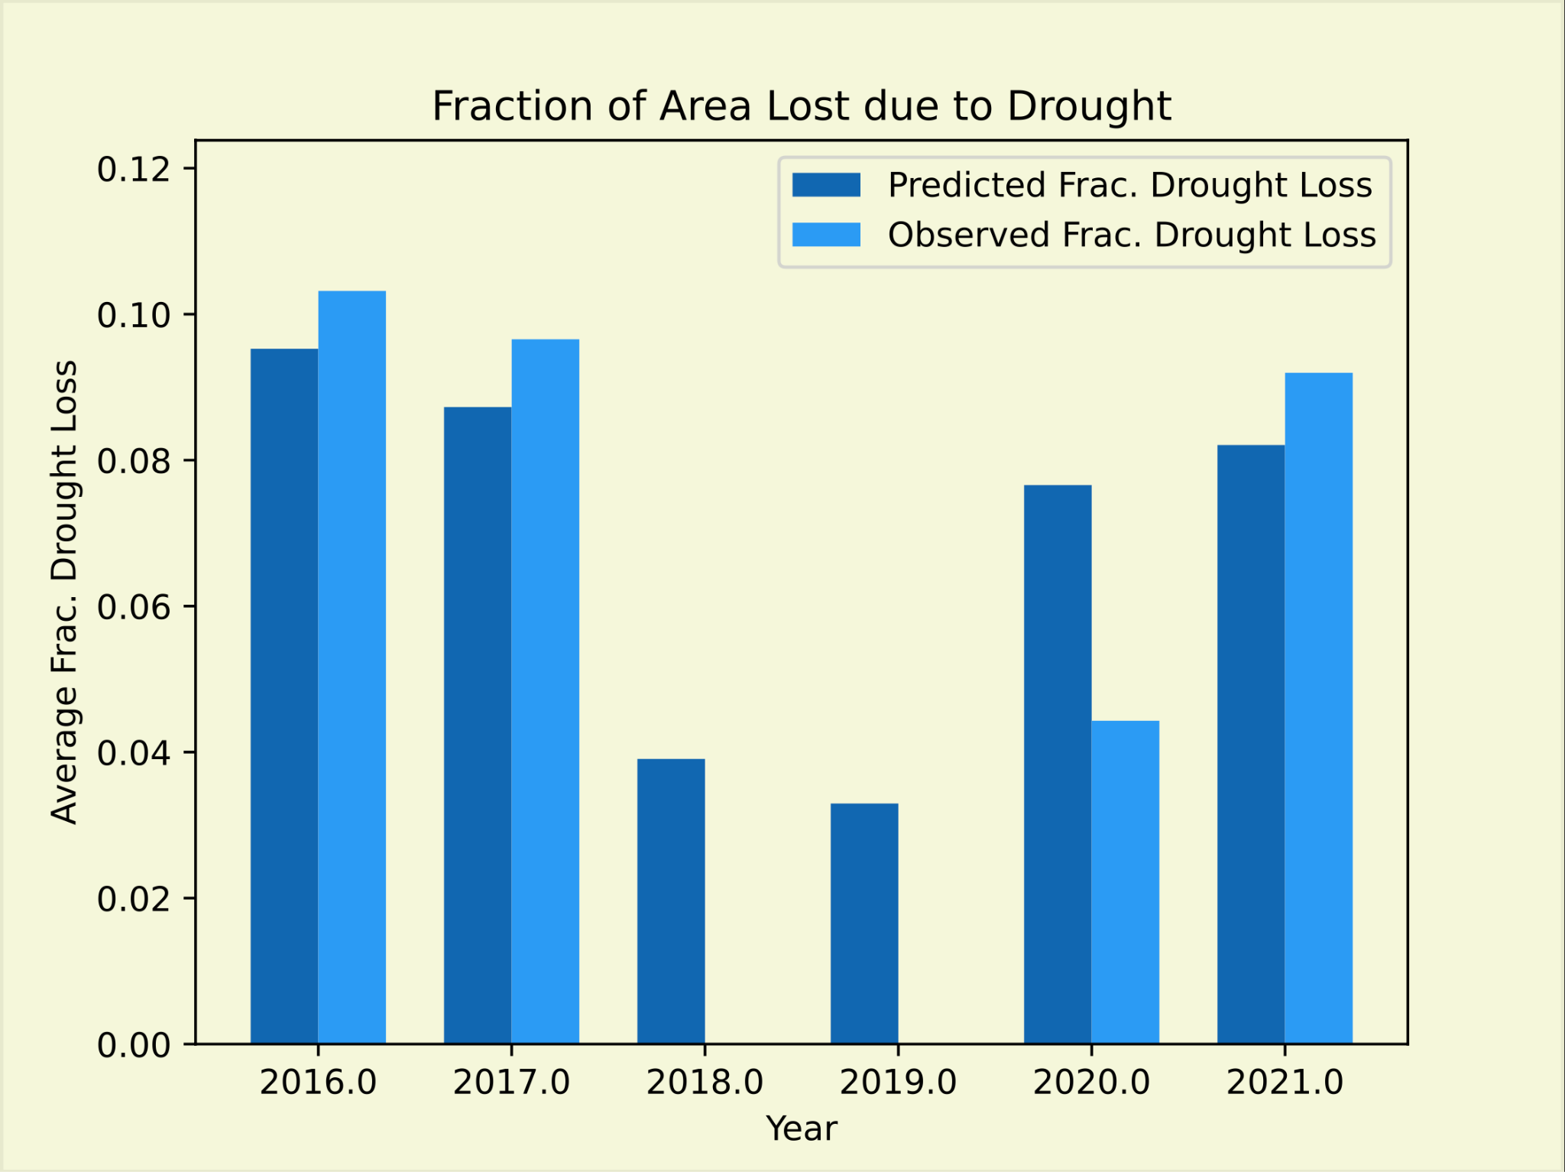
Objective 2: Fill Data Gap (temporal)
Missing data due to poor survey data quality
Notes:
We were not limited to predicting across space. We have data and features for every year from 2015-2022, except for 2018 and 2019 which had significant data quality issues, so we were also able to predict across time and fill the temporal data gaps in these years.
Here are our temporal predictions for drought across the entire country, which are in alignment with the observed drought conditions during this time period. As you can see, the southern and western regions of the country are particularly vulnerable, and an estimated 2.3 million people (20% of the population) were affected by severe food insecurity following the drought in 2017.
Since features can be generated at any time as long as there’s satellite coverage of the region, these predictions could be used to supplement early warning systems before harvesting. This would give more time to governing institutions and humanitarian organizations to prepare emergency aid to areas of the country that need it most.

Slide 50
Objective 2: Fill Data Gap (spatial + temporal)
Notes:
We were not limited to predicting across space. We have data and features for every year from 2015-2022, except for 2018 and 2019 which had significant data quality issues, so we were also able to predict across time and fill the temporal data gaps in these years. Here are our temporal predictions for drought across the entire country, which are in alignment with the observed drought conditions during this time period. As you can see, the southern and western regions of the country are particularly vulnerable, and an estimated 2.3 million people (20% of the population) were affected by severe food insecurity following the drought in 2017.
Since features can be generated at any time as long as there’s satellite coverage of the region, these predictions could be used to supplement early warning systems before harvesting. This would give more time to governing institutions and humanitarian organizations to prepare emergency aid to areas of the country that need it most.
Need to show that theres actually a gap here - Bar chart that shows we’re missing 2018 and 2019 data

Slide 51
MOSAIKS.org
Images left to righ (Noun Project)t: Vectors Market, LSE Designs

Slide 52
Exciting Developments

Slide 53
Exciting Developments

Slide 54
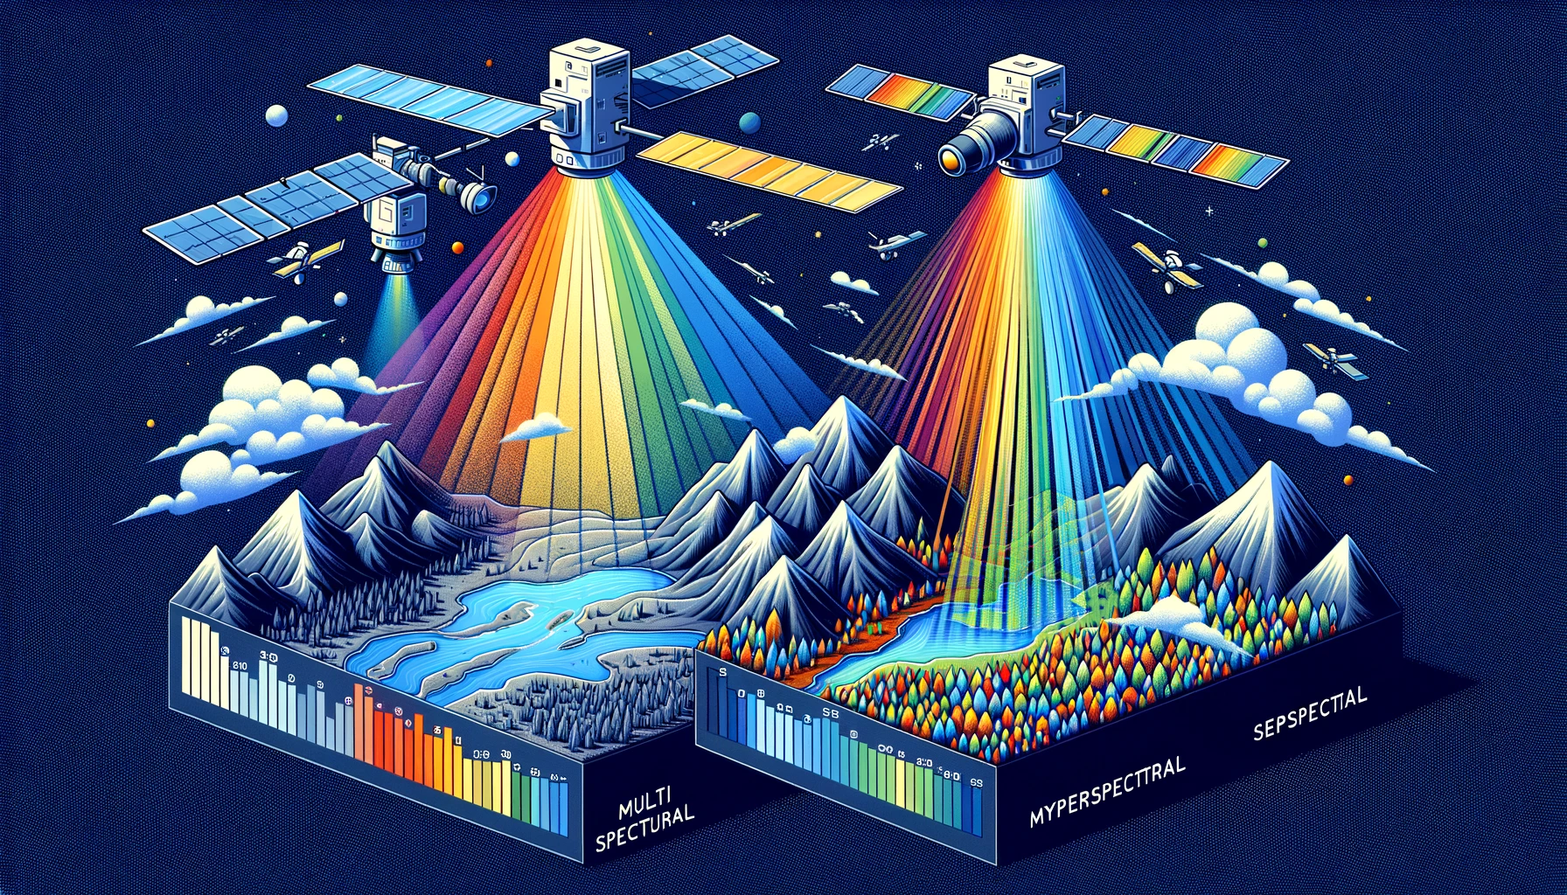
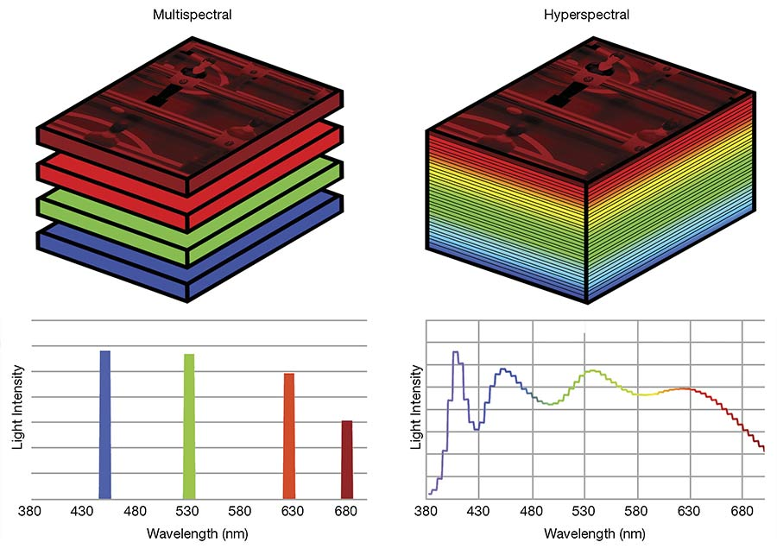
Exciting Developments

Slide 55
Exciting Developments

